Slide 1
Machine Learning Algorithms (IV)
Master´s in Applied Artificial Intelligence
Luís Ferreira
lufer@ipca.pt

Slide 2
Overview
Part I
Artificial Intelligence and Machine Learning
Foundations
Part II
Machine Learning
Part III
Machine Learning Algorithms
Parte V
Advanced ML
Parte IV
Building a ML Model

Slide 3
Part III
Machine Learning Algorithms
Competencies to be acquired:
Choosing ML Algorithms
Create ML Regression models

Slide 4
Part III: MLA
ML
Type of ML Algorithms (review)
  Supervised ML Algorithms (SVL)
    Regression, Classification, Forecasting
  Unsupervised ML Algorithms
    Clustering, Dimensionality Reduction
  Semi-Supervised ML Algorithms
  Reinforcement ML Algorithms
Notes:
https://labelyourdata.com/articles/how-to-choose-a-machine-learning-algorithm

Slide 5
Part III: MLA
Modelling
Choosing the best estimator/algorithm/solver/model
  Classification problem - predicting a category (it will rain or not)
  Regression problem – predicting a value|number (the temperature)
Regression is a statistical method used in machine learning to model and analyze the relationships between a dependent variable (output) and one or more independent variables (inputs). It aims to predict the dependent variable’s value based on the independent variables’ values.
https://www.analyticsvidhya.com/

Slide 6

Part III: MLA
Modelling
Choosing the best estimator/algorithm
  In Sklearn refers Algorithms or Machine Learning Models as “estimators”
  Classification problem - predicting a category (it will rain or not)
  Regression problem – predicting a number (the temperature)
https://scikit-learn.org/stable/tutorial/machine_learning_map/index.html

Slide 7
Part III: MLA
Regression Modelling
Notes:
Dependent and Independent Variables: relationship between the dependent (targets) and independent (inputs) variables.
Regression Coefficients: parameters of the regression model that are estimated from the data.
Regression Line: is the line that best fits the data points (in linear regression)
Residuals: The differences between the predicted values and the actual values.
Notes:
https://www.geeksforgeeks.org/choosing-a-suitable-machine-learning-algorithm/

Slide 8
Part III: MLA
Regression Modelling
Notes:
Loss Function: Measures the model’s error. Examples include Mean Squared Error (MSE) and Mean Absolute Error (MAE).
Overfitting and Underfitting: intends to balance complexity and simplicity to generalize well on unseen data.
Regularization Techniques: methods used to avoid overfitting by penalizing large coefficients (ridge and lasso regression)
Notes:
https://www.geeksforgeeks.org/choosing-a-suitable-machine-learning-algorithm/

Slide 9
Part III: MLA
Regression Modelling
SVL (Theorical)
SVM (Machine) - Classification
Algorithms for Regression
  ( Linear | Polynomial | Exponential | Logistic | Logarithmic ) Regression
  Decision Tree | Random Forest Regressor
  Support Vector Regression (SVR)
  KNN Regression
  Ridge | Lasso Regression
  Robust Regression — RANSAC
SVR - Regression
Notes:
https://www.analyticsvidhya.com/blog/2021/05/5-regression-algorithms-you-should-know-introductory-guide/

Slide 10
Part III: MLA
Regression Modelling
“A data point is similar to the points closest to it.”
Note:
KNN (k-Nearest Neighbours' algorithm): used in regression to predict continuous values
  Main principle of KNN (for classification)
    1- Find the k closest data points (neighbors) in the dataset.
    2 - Use those neighbors to make a prediction.
  Take the average (or weighted average) of the neighbors’ target values.
Example:
Predict house price → average prices of nearby houses.
Notes:
https://www.geeksforgeeks.org/choosing-a-suitable-machine-learning-algorithm/

Slide 11
Part IV: MLA
Regression Modelling
Factors to Choose Correct Algorithm
  The kind of model in use (problem)
  Analysing the available Data (size of training set)
  The accuracy of the model
  Time taken to train the model (training time)
  Number of parameters
  Number of features
  Linearity
Notes:
https://www.geeksforgeeks.org/choosing-a-suitable-machine-learning-algorithm/

Slide 12
Part IV: MLA
Regression Model Evaluation (review slides)
Regression Model Evaluation Metrics/Techniques
Mean Absolute Error (MAE) - The average of the absolute differences between predictions and actual values. It gives you an idea of how wrong your predictions were.
  MAE gives a better indication of how far off each of your model's predictions are on average.
Mean Squared Error (MSE) - The average squared differences between predictions and actual values. Squaring the errors removes negative errors. It also amplifies outliers (samples which have larger errors).
Lower is better!!!
Notes:
https://towardsdatascience.com/understanding-auc-roc-curve-68b2303cc9c5
Thresholds == limiares|limites

Slide 13
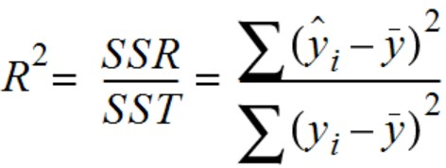
Part IV: MLA
Regression Model Evaluation (review slides)
Regression Model Evaluation Metrics/Techniques
R² (pronounced r-squared) or the coefficient of determination - Compares the model's predictions to the mean of the targets. Values can range from negative infinity (−∞ - a very poor model) to 1.
R² is similar to accuracy. It gives you a quick indication of how well your model might be doing. Generally, the closer your R² value is to 1.0, the better the model.
Adjusted R² – used in multiple regression. Penalizes the inclusion of unnecessary independent variables… provide a more realistic measure of model fit.
Higher is better!!!
Notes:
https://towardsdatascience.com/understanding-auc-roc-curve-68b2303cc9c5
Thresholds == limiares|limites

Slide 14
Part IV: MLA
Regression Model Evaluation (review slides)
Which metric to use?
Scenario Recommended Metric
Interpretability MAE
Penalize big errors RMSE
Model comparison RMSE, R²
Business reporting MAE, MAPE
Feature selection Adjusted R²
Notes:
https://towardsdatascience.com/understanding-auc-roc-curve-68b2303cc9c5
Thresholds == limiares|limites

Slide 15
Part IV: MLA
Regression Model Evaluation
Regression
Simple (Linear Regression)
  Y, X
Multiple
  Y, X₁ + X₂ + …+ X₃
Notes:
https://towardsdatascience.com/understanding-auc-roc-curve-68b2303cc9c5

Slide 16
Part IV: MLA
Regression Model Evaluation
Regression Multiple (Y, X₁ + X₂ + …+ X₃)
Analyze each independent variable with y, individually (each X with Y)
Generate individual scatter plots
Look for redundancies (same influence over Y)
Notes:
https://towardsdatascience.com/understanding-auc-roc-curve-68b2303cc9c5
Scatter Plots: graficos de dispersão
Remover redundâncias

Slide 17
Part IV: MLA
Regression Model Evaluation
Regression Multiple (Y, X₁ + X₂ + …+ X₃)
Linearity and Parsimony
  Collinearity: two independent variables that are correlated
    Including collinear independent variables can damage the model, creating unreliable predictions
  Parsimony: don't include variables that don't improve the model at all (can create parsimonious models)
Notes:
https://towardsdatascience.com/understanding-auc-roc-curve-68b2303cc9c5
Scatter Plots: graficos de dispersão
Remover redundâncias

Slide 18
Part IV: MLA
Regression Model Evaluation
Regression Multiple (Y, X₁ + X₂ + …+ X₃)
Basic Requirements (explore correlation matrix)
  Linearity between dependent variable (target) and the independent variables
  Minimize collinearity
  Residuals:
    Close to normal distribution
    Constant variance with respect to the d best aj line
    Independent (no pattern)
Notes:
https://towardsdatascience.com/understanding-auc-roc-curve-68b2303cc9c5
Scatter Plots: graficos de dispersão
Remover redundâncias

Slide 19
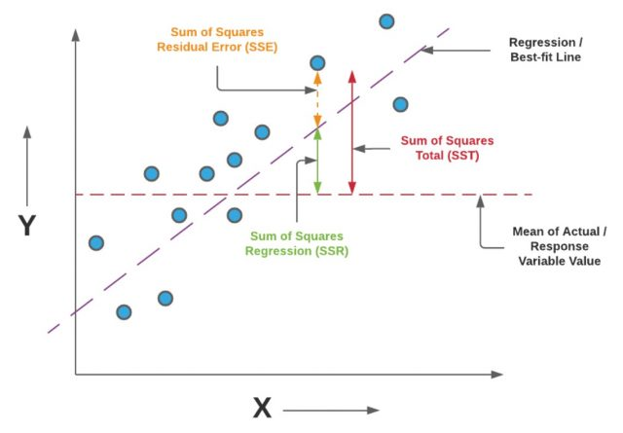
Sum of Squares Total (SST) (or Residual Sum of Squares)
Sum of Squares due to Regression (SSR)
ŷ – predicted value
ȳ – mean value
y_true = np.array([3, 5, 7, 9])
y_pred = np.array([2.5, 5.3, 6.8, 9.1])
ss_res = np.sum((y_true - y_pred) ** 2)
ss_tot = np.sum((y_true - np.mean(y_true)) ** 2)
r2 = 1 - (ss_res / ss_tot)
https://vitalflux.com/r-squared-explained-machine-learning/
Note:
Correlation (r) measures strength of linear association
R² measures how well a specific regression model explains variance
Notes:
https://towardsdatascience.com/understanding-auc-roc-curve-68b2303cc9c5
Thresholds == limiares|limites

Slide 20
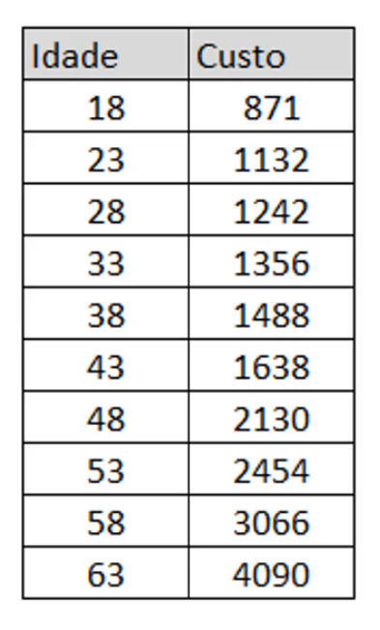
Part IV: MLA
Regression Model – Case study
Questions:
Is there any relation between age (idade) and
cost (custo)?
If so, what kind of relation? Strong? Positive?
What are the cost of a person with 45 years old?
Notes:
https://towardsdatascience.com/understanding-auc-roc-curve-68b2303cc9c5
Thresholds == limiares|limites

Slide 21
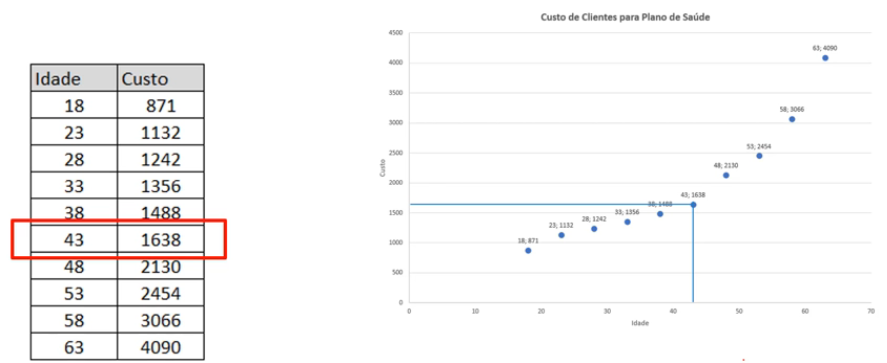
Part IV: MLA
Regression Model – Case study
Questions:
Is there any relation between age (idade) and
cost (Custo)?
If so, what kind of relation? Strong? Positive?
What are the cost of a person with 45 years old?
Y axis
Answers or Dependent variable
The target to predict
X axis
Explanatory or Independent variable
Used to predict
Notes:
https://towardsdatascience.com/understanding-auc-roc-curve-68b2303cc9c5
Thresholds == limiares|limites

Slide 22
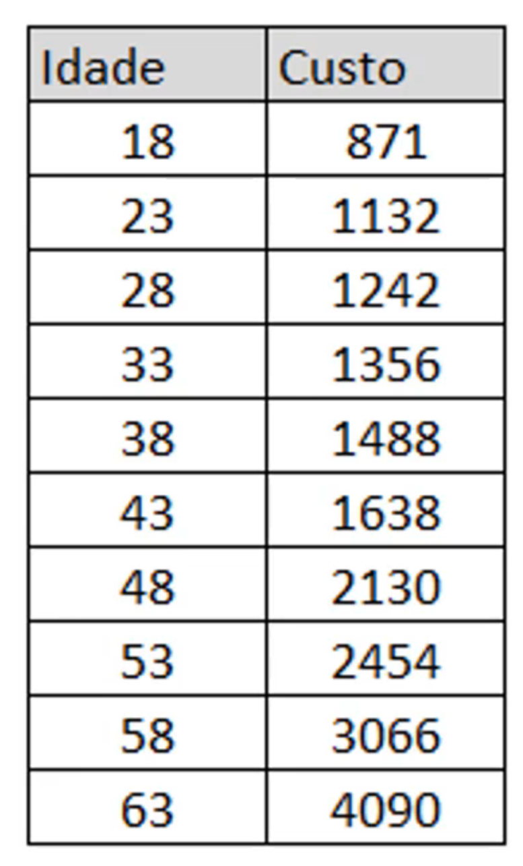
Part IV: MLA
Regression Model – Case study
Correlation (r): ?
R² = ?
Notes:
https://towardsdatascience.com/understanding-auc-roc-curve-68b2303cc9c5
Thresholds == limiares|limites

Slide 23
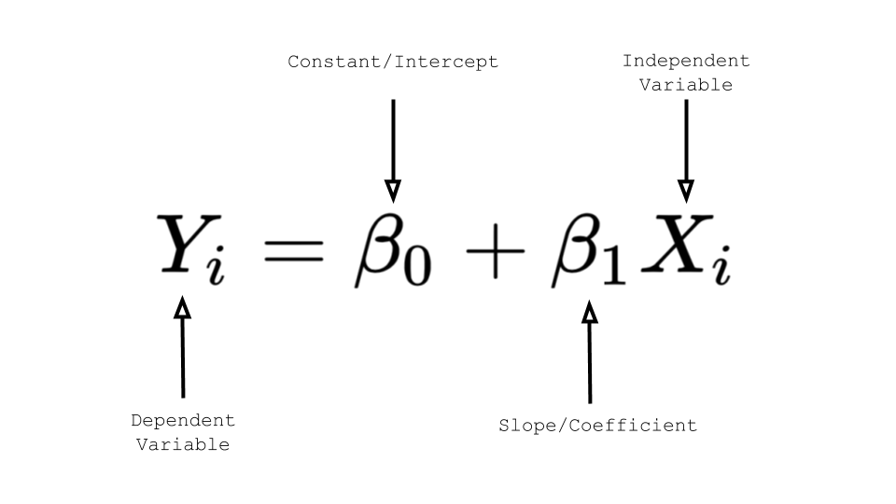
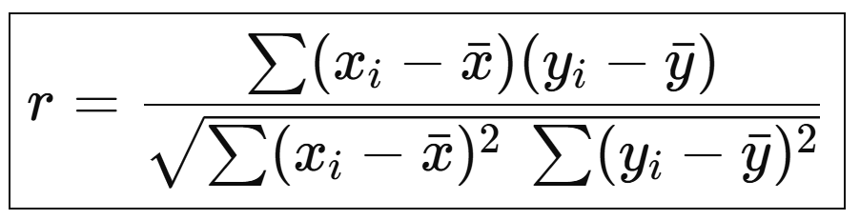
Part IV: MLA
Regression Model – Case study
ŷ – predicted value
ȳ – mean value
x (Idade) | y (Custo) | ŷ (Predicted) | (y-ȳ)² | (y-ŷ)²
18 | 871 | 554.67 | 1,157,130.49 | 100,062.94
23 | 1132 | 864.01 | 663,736.09 | 71,817.50
28 | 1242 | 1173.35 | 496,602.09 | 4,712.61
33 | 1356 | 1482.69 | 348,926.49 | 16,050.59
38 | 1488 | 1792.03 | 210,405.69 | 92,434.43
43 | 1638 | 2101.37 | 95,295.69 | 214,711.48
48 | 2130 | 2410.71 | 33,598.89 | 78,797.59
53 | 2454 | 2720.05 | 257,353.29 | 70,781.80
58 | 3066 | 3029.39 | 1,252,832.49 | 1,340.45
63 | 4090 | 3338.73 | 4,593,734.89 | 564,410.71
Notes:
https://towardsdatascience.com/understanding-auc-roc-curve-68b2303cc9c5
Thresholds == limiares|limites

Slide 24
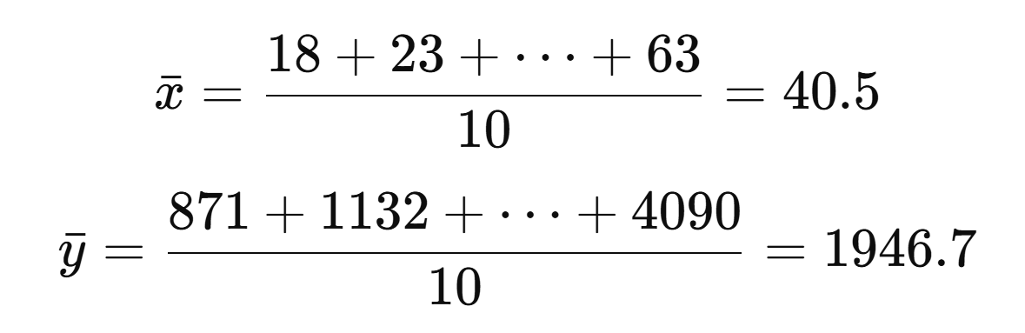
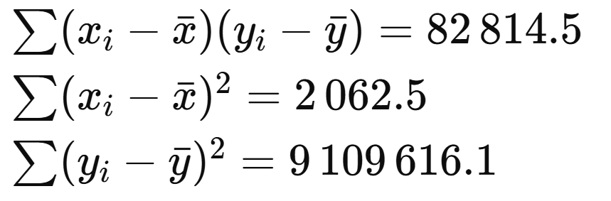
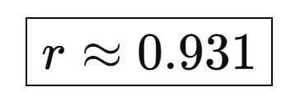
Part IV: MLA
Regression Model – Case study
ŷ – predicted value
ȳ – mean value
x (Idade) | y (Custo) | ŷ (Predicted) | (y-ȳ)² | (y-ŷ)²
18 | 871 | 554.67 | 1,157,130.49 | 100,062.94
23 | 1132 | 864.01 | 663,736.09 | 71,817.50
28 | 1242 | 1173.35 | 496,602.09 | 4,712.61
33 | 1356 | 1482.69 | 348,926.49 | 16,050.59
38 | 1488 | 1792.03 | 210,405.69 | 92,434.43
43 | 1638 | 2101.37 | 95,295.69 | 214,711.48
48 | 2130 | 2410.71 | 33,598.89 | 78,797.59
53 | 2454 | 2720.05 | 257,353.29 | 70,781.80
58 | 3066 | 3029.39 | 1,252,832.49 | 1,340.45
63 | 4090 | 3338.73 | 4,593,734.89 | 564,410.71
Correlation (r): 0,93 (strong)
R² = 0.86
86% of the dependent variable (cost) is explained by the independent variable (age)
14% is due to variables not included in the model or ignored
Notes:
https://towardsdatascience.com/understanding-auc-roc-curve-68b2303cc9c5
Thresholds == limiares|limites

Slide 25
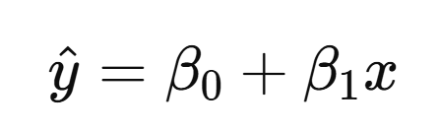
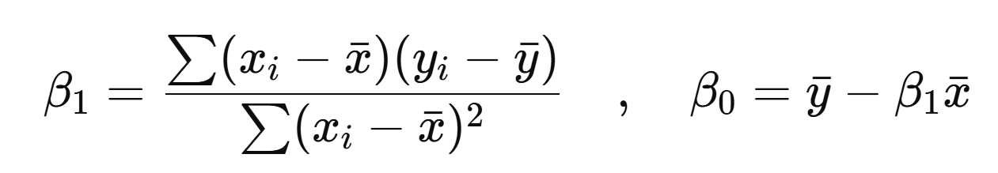
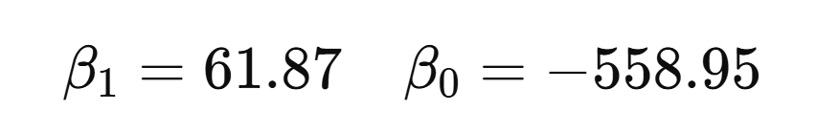
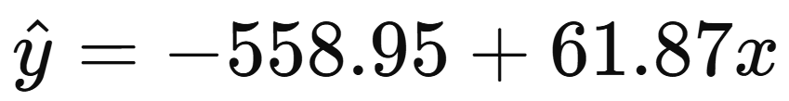
Part IV: MLA
Regression Model – Case study
ŷ – predicted value
ȳ – mean value
x (Idade) | y (Custo) | ŷ (Predicted) | (y-ȳ)² | (y-ŷ)²
18 | 871 | 554.67 | 1,157,130.49 | 100,062.94
23 | 1132 | 864.01 | 663,736.09 | 71,817.50
28 | 1242 | 1173.35 | 496,602.09 | 4,712.61
33 | 1356 | 1482.69 | 348,926.49 | 16,050.59
38 | 1488 | 1792.03 | 210,405.69 | 92,434.43
43 | 1638 | 2101.37 | 95,295.69 | 214,711.48
48 | 2130 | 2410.71 | 33,598.89 | 78,797.59
53 | 2454 | 2720.05 | 257,353.29 | 70,781.80
58 | 3066 | 3029.39 | 1,252,832.49 | 1,340.45
63 | 4090 | 3338.73 | 4,593,734.89 | 564,410.71
Correlation (r): 0,93 (strong)
R² = 0.86
86% of the dependent variable (cost) is explained by the independent variable (age)
14% is due to variables not included in the model or ignored
Notes:
https://towardsdatascience.com/understanding-auc-roc-curve-68b2303cc9c5
Thresholds == limiares|limites

Slide 26
Part IV: MLA
Regression Model – Case study
Pearson Correlation coefficient (r):
0,93 (strong) -> “As Age increases, Cost increases”
Coefficient of determination (R²)
0.86 (==r²)
86% of the dependent variable (cost) is explained by the independent variable (age)
14% is due to variables not included in the model or ignored
Notes:
https://towardsdatascience.com/understanding-auc-roc-curve-68b2303cc9c5
Thresholds == limiares|limites

Slide 27
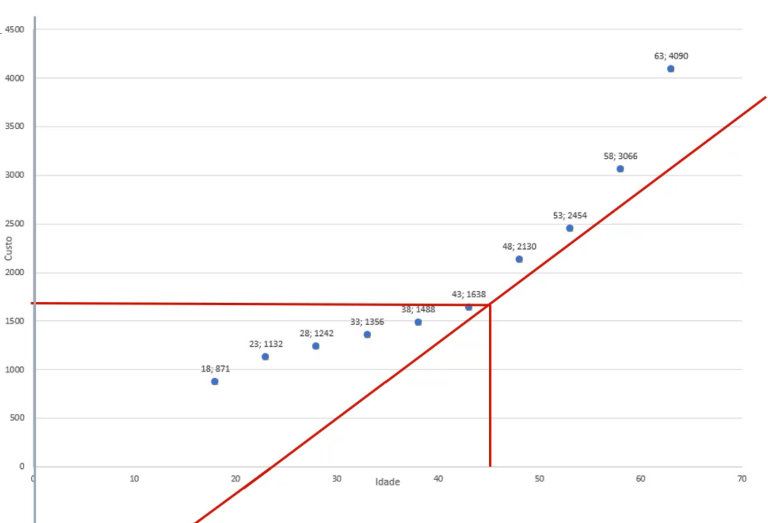
Part IV: MLA
Regression Model – Case study
How to calculate the predicting curve?
Interception point (when x=0)
Inclination or slope
Notes:
https://towardsdatascience.com/understanding-auc-roc-curve-68b2303cc9c5
Thresholds == limiares|limites

Slide 28
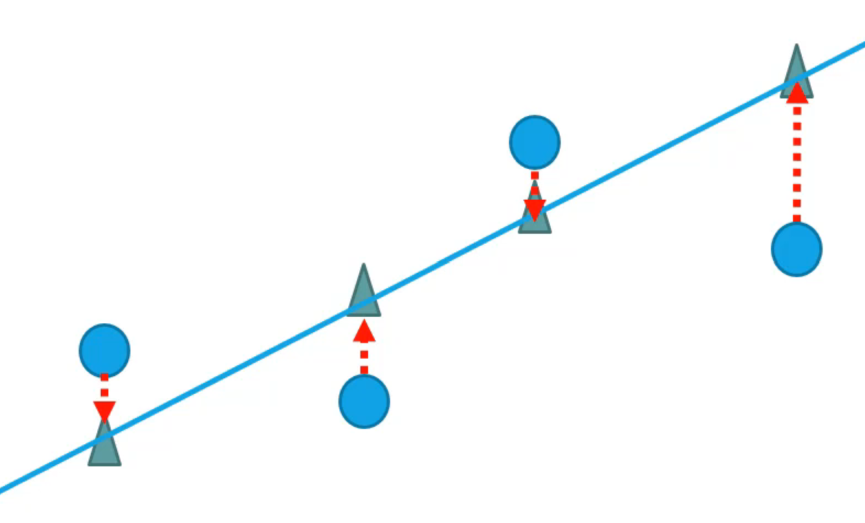
Part IV: MLA
Regression Model – Case study
Predicted Value (x) = Interception + ( Slope * Value to Predict )
x = ip + (s * v)
Suppose the example:
  v (age)= 56
  s (slope) = 61,86
  ip (interception point) = -568,94
  x = -568,94 + (61,86 * 56)
  x = 2905,22
How to calculate the predicting curve?
Interception point (when x=0)
Inclination or slope
Read more about:
Residuals
Adjusted values
See Jupiter Noteboook
Notes:
https://towardsdatascience.com/understanding-auc-roc-curve-68b2303cc9c5
Thresholds == limiares|limites

Slide 29
Part IV: MLA
Regression Model Evaluation
Regression Calculus
Correlation
Inclination
Interception
Predicting
Notes:
https://towardsdatascience.com/understanding-auc-roc-curve-68b2303cc9c5
Scatter Plots: graficos de dispersão
Remover redundâncias

Slide 30
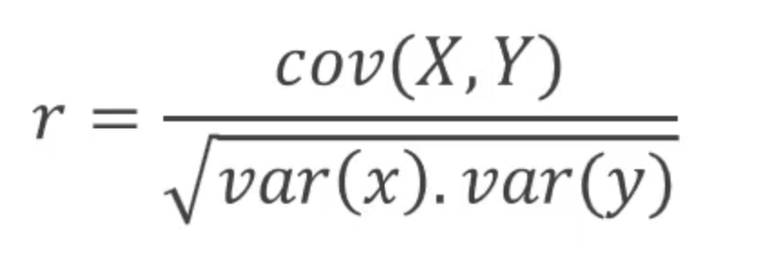
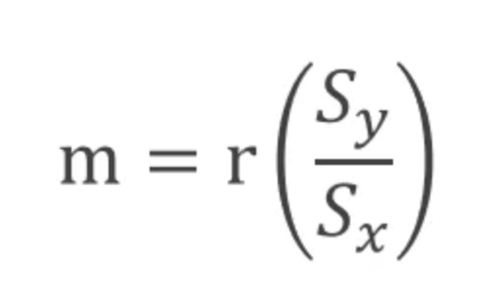
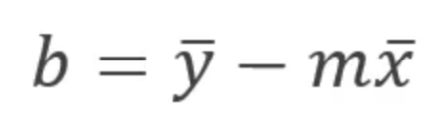
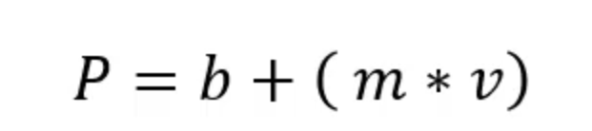
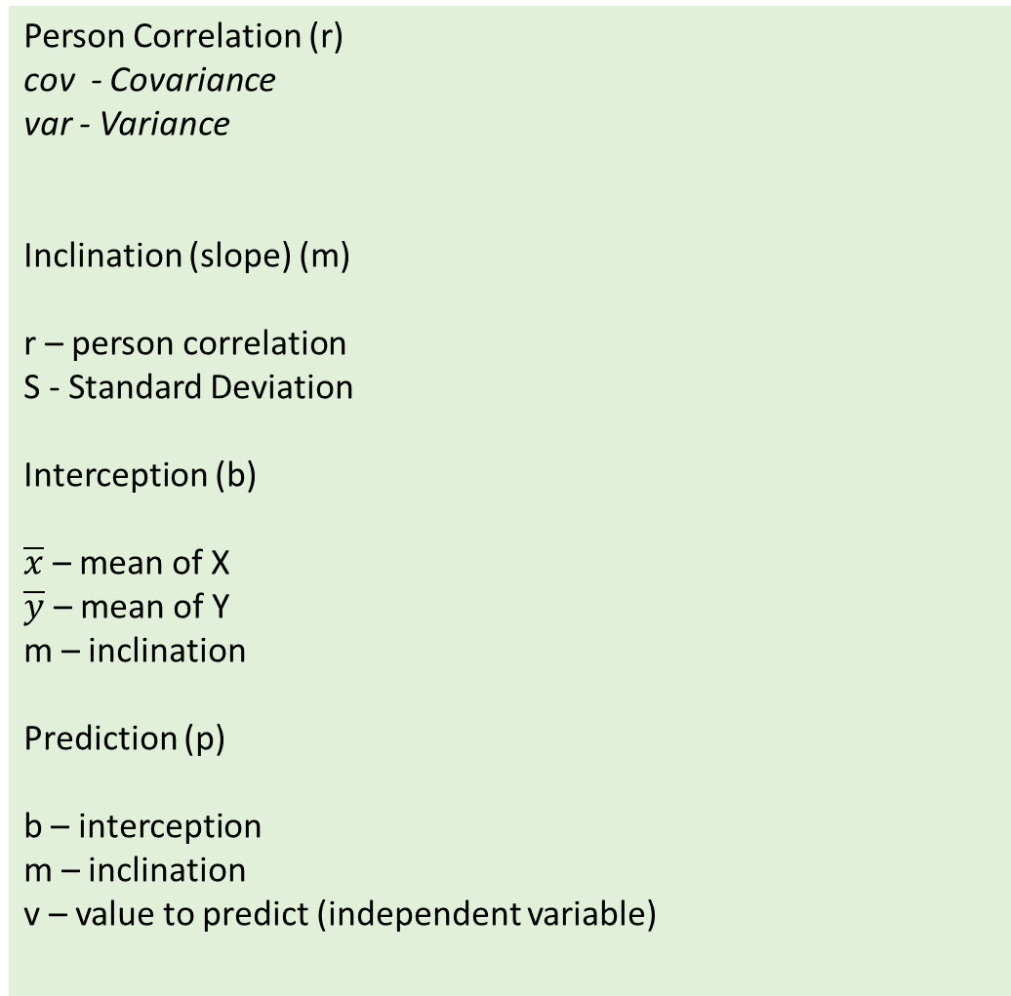
Part IV: MLA
Regression Model Evaluation
Person Correlation (r)
cov - Covariance
var - Variance
Inclination (slope) (m)
r – person correlation
S - Standard Deviation
Interception (b)
$\overline{x}$ – mean of X
$\overline{y}$ – mean of Y
m – inclination
Prediction (p)
b – interception
m – inclination
v – value to predict (independent variable)
Calculus
Notes:
https://towardsdatascience.com/understanding-auc-roc-curve-68b2303cc9c5
Scatter Plots: graficos de dispersão
Remover redundâncias

Slide 31
Part III: MLA
Regression Modelling
See
Jupyter notebook
7_Modelling_Regression.ipynb
See
https://www.analyticsvidhya.com/blog/2021/05/5-regression-algorithms-you-should-know-introductory-guide/
Notes:
https://vitalflux.com/classification-problems-real-world-examples/

Slide 32
Progress
Part I
Artificial Intelligence and Machine Learning
Foundations
Part II
Machine Learning
Part III
Machine Learning Algorithms (I)
Part IV
Machine Learning Algorithms (I)
Part V
Advanced ML

Slide 33
References
Machine Learning. Tom M. Mitchel, McGraw-Hill, 1997
Machine Learning for Everyone
  https://vas3k.com/blog/machine_learning/
Machine Learning Tutorial
  https://www.simplilearn.com/tutorials/machine-learning-tutorial/machine-learning-steps
What is machine learning and how does it work? In-depth guide
  https://www.techtarget.com/searchenterpriseai/definition/machine-learning-ML

Slide 34
Appendices

